Slide 1
Building Better Brains:
The Core Story of Early Brain and Child Development (EBCD)
Material developed by the Early Brain and Child Development Leadership Workgroup
A program of the American Academy of Pediatrics

Slide 2
Objectives
To highlight the importance of Early Brain & Child Development (EBCD)
To review what influences shape the developing brain
To discuss what we can do to promote optimal early brain development

Slide 3

Our Agenda:
“It’s all about nurturing relationships. Early relationships build
their brains and our future.”

Slide 4

“Change the First Five Years and You Change Everything”
http://www.youtube.com/watch?v=GbSp88PBe9E

Slide 5
Why is EBCD Important?
Before the age of 5, it takes less time, intensity and repetition to organize the developing neural systems than it does to reorganize already-developed neural systems
What happens early affects all aspects of a child’s development
First 1,000 days of life have a profound impact on brain development
Nurturing relationships in the early years are critical
Toxic stress has a negative impact on a child’s development
Early interventions are critical for optimal life course outcomes
Source: Center on the Developing Child at Harvard University
Notes:
Work in neuroscience, molecular biology, and genomics tells us the following:
Before the age of 5. It takes less time, intensity and repetition to organize the developing neural systems than it does to reorganize already-developed neural systems
Early relationships, environments, and experiences affect all aspects of a child’s development
Nurturing relationships with parents/caregivers in the early years are critical
The first 1000 days from pregnancy to 2 years is a time period that can have a profound impact on a child’s growth and development
Toxic stress has a negative impact on a child’s development. Significant adversity can produce physiological disruptions or biological “memories” that can undermine the development of the body’s stress response systems and affect the developing, brain, cardiovascular system, immune system and metabolic regulatory controls
Early interventions are critical for optimal life course outcomes because these physiological disruptions can persist far into adulthood and lead to lifelong impairments in both physical and mental health

Slide 6
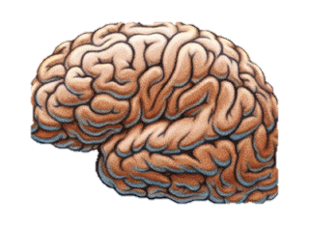
Why Early Experiences Matter
Newborn Brain
Average Weight
333 grams
2 Year Old’s Brain
Average Weight
999 grams
Brain photo courtesy IsaacMao, Flickr
Notes:
Work in neuroscience, molecular biology, and genomics tells us the following:
Before the age of 5. It takes less time, intensity and repetition to organize the developing neural systems than it does to reorganize already-developed neural systems
Early relationships, environments, and experiences affect all aspects of a child’s development
Nurturing relationships with parents/caregivers in the early years are critical
The first 1000 days from pregnancy to 2 years is a time period that can have a profound impact on a child’s growth and development
Toxic stress has a negative impact on a child’s development. Significant adversity can produce physiological disruptions or biological “memories” that can undermine the development of the body’s stress response systems and affect the developing, brain, cardiovascular system, immune system and metabolic regulatory controls
Early interventions are critical for optimal life course outcomes because these physiological disruptions can persist far into adulthood and lead to lifelong impairments in both physical and mental health

Slide 7
Synapses form based on early experiences
Mind is fine tuned to the world children inhabit
Born with lifetime supply of neurons
Birth
3 Years
15 Years
Notes:
Work in neuroscience, molecular biology, and genomics tells us the following:
Before the age of 5. It takes less time, intensity and repetition to organize the developing neural systems than it does to reorganize already-developed neural systems
Early relationships, environments, and experiences affect all aspects of a child’s development
Nurturing relationships with parents/caregivers in the early years are critical
The first 1000 days from pregnancy to 2 years is a time period that can have a profound impact on a child’s growth and development
Toxic stress has a negative impact on a child’s development. Significant adversity can produce physiological disruptions or biological “memories” that can undermine the development of the body’s stress response systems and affect the developing, brain, cardiovascular system, immune system and metabolic regulatory controls
Early interventions are critical for optimal life course outcomes because these physiological disruptions can persist far into adulthood and lead to lifelong impairments in both physical and mental health

Slide 8

The Biology of Health
The architecture of the brain depends on the mutual influences of the following
  Genetics
  Environment
  Experience
Source: National Scientific Council on the Developing Child, Working Paper 5, The Timing and Quality of Early Experiences Combine to Shape Brain Architecture. Center on the Developing Child at Harvard University.
Notes:
But we know that the architecture of the brain depends on the mutual influences of the following:
Genetics: Genetics supply a basic plan for brain development. It provides the structure for the brain’s architecture and supplies the means for interconnecting nerve cells within and across circuits.
Environment: The environment that the brain has to develop in has a profound influence in shaping the capacity of the brain. This begins prenatally with brains needing an abundant supply of nutrients. An adverse prenatal environment can actually alter the genetic plans.
Experience: Experience refers to the interaction the child has with his or her environment. Healthy and stimulating experience results in brain architecture that is able to operate at its full genetic potential. You can have genetics present and environment present, but if interaction with that environment is prevented, the brain will not benefit.
Persistent adversity, also referred to as toxic stress, leads to weak brain architecture with impaired capabilities.

Slide 9
The Foundations of Health
Stable and responsive environment and relationships
Safe and supportive physical, chemical and built environments
Appropriate nutrition
Source: Center on the Developing Child at Harvard University
Notes:
The biology of health explains how experiences and environmental influences interact with genetic predispositions which result in various combinations of physiological adaptation and disruption that can affect lifelong health, mental well-being, learning and behaviors. This highlights the importance of understanding and addressing the early childhood origins of lifelong illness and disability.
The foundations of health are three domains that provide a context within which the early roots of physical and mental well-being are nourished. These are:
A stable and responsive environment of relationships
Safe and supportive physical, chemical and built environments
Appropriate nutrition
The first 1000 days, as noted earlier is a window of opportunity that can greatly influence later health and the ability to grow and learn. Helping build a strong foundation in the first 1,000 days is key to building better brains and futures.

Slide 10
Stable and Responsive Environments
Provide consistent, nurturing and protective interactions with adults
Positive relationships can serve as social-emotional buffers
Source: Center on the Developing Child at Harvard University
Notes:
Stable and responsive environments of relationships provide child with consistent, nurturing and protective interactions with adults that enhance their learning. This helps them develop adaptive capacities that promote well-regulated stress response. These positive relationships can serve as social/emotional buffers. With sufficient levels of social emotional buffering, the stress response can be either positive (and actually build resilience), or tolerable (and result in no sustained changes, positive or negative).
With insufficient levels of social-emotional buffering, the physiologic stress response is prolonged and becomes toxic, resulting in potentially permanent alterations to the epigenome, brain structure, and behavior.

Slide 11

Safe and Supportive
Physical Environments
Safe places to learn
Places free of toxins
Places that support families
Source: Center on the Developing Child at Harvard University
Notes:
Children need safe places to play and learn. They need places that are free from toxins and fears so that they can explore without significant risk of harm. Families need places that support them in raising healthy children. In summary, children need environments that are prepared to nurture them.

Slide 12
What shapes the developing brain?
Notes:
Early environments and experiences have an exceptionally strong influence on brain architecture. After most neural circuits in the brain have matured, their genetic plans and architecture can still be modified by experience, but the extent of these modifications tends be far more limited. This means that what happens early has a unique advantage in shaping the architecture of developing brain circuits before they are fully mature and stabilized.
The science of pediatrics relies upon not just biology but also various health and development factors – and increasingly, the role of “ecology”, meaning the environments that child are raised in. These all influence each others through the routes of neuroscience, life course sciences, and epigenetics.
This diagram was developed based on a number of sources including:
Bronfenbrenner U. The Ecology of Human Development: Experiments by Nature and Design. Cambridge, MA: Harvard University Press; 1979.
Sameroff A. A unified theory of development: a dialectic integration of nature and nurture. Child Dev. 2010;81(1):6–22.
National Research Council, Institute of Medicine, Committee on Integrating the Science of Early Childhood Development; Shonkoff JP, Phillips D, eds. From Neurons to Neighborhoods: The Science of Early Childhood Development, Washington DC, National Academies Press; 2000.

Slide 13
Shaping the Capacity of the Brain
The interactive influences of genes and experiences shape the architecture of the developing brain
Brains are built from the bottom up
Notes:
The interactive influences of genes and experience literally shape the architecture of the developing brain and the active ingredient is the “serve and return” nature of children’s engagement in relationships with their parents and other caregivers in their family and community.
[Note to Presenter: If there’s time, you can show the 1:43 Serve and Return video - http://developingchild.harvard.edu/resources/multimedia/videos/three_core_concepts/serve_and_return/]
Both brain architecture and developing abilities are built from the bottom up with simple circuits and skills providing scaffolding for more advanced circuits and skills over time.
Source: The Science of Early Child Development, The National Scientific Council on the Developing Child, 2007.

Slide 14
Early Stress
TOXIC STRESS
CHILDHOOD STRESS
Hyper-responsive stress response; calm/coping
Chronic “fight or flight;” cortisol / norepinephrine
Changes in Brain Architecture
Notes:
Toxic stress in early childhood also shapes the brain, but in a negative fashion. Toxic stress is associated with persistent effects on the nervous system and stress hormone systems that can damage developing brain architecture and lead to lifelong problems in learning, behavior, as well as physical and mental health.

Slide 15
Early Stress
Source: Bruce Perry, MD, PhD, Child Trauma Academy
Notes:
This picture demonstrates how toxic stress (in this case, via extreme neglect) early in life can change physical brain architecture.

Slide 16
Development results from an on-going, re-iterative, and cumulative dance between nurture and nature
Experience
Protective and Personal
(versus Insecure and Impersonal)
Brain Development
Alterations in Brain
Structure and Function
Epigenetic Changes
Alterations in the Way the
Genetic Program is Read
Behavior
Adaptive or Healthy Coping Skills
(vs. Maladaptive or Unhealthy Coping)
Source: AAP: Helping Foster And Adoptive Families Cope with Trauma. 2013.
Notes:
Development results from an on-going, re-iterative and cumulative dance between nurture and nature. Remember that not so long ago we used to think that we couldn’t really alter genetics within a single individual, but the evolving science of epigenetics has shown us that’s not always the case.
Creating the right conditions for early childhood development is likely to be more effective and less costly than addressing problems at a later age. (Source: The Science of Early Childhood Development, The National Scientific Council on the Developing Child, 2007.)

Slide 17

What can we do?
Nearly 90% of young children see a child health provider at least annually for a check-up, while less than 1/3 are in any child care setting, the next most common contact with a formal service system.
Source: Charles Bruner, writing in The Colorado Trust’s Issue Brief: Connecting Health and School Readiness, February 2009
Notes:
While EBCD is a multidisciplinary effort that should include, involve and collaborate with virtually any area that “touches” young children, the fact remains that health care providers are one of the few consistent, universal points of intersection with young children.

Slide 18
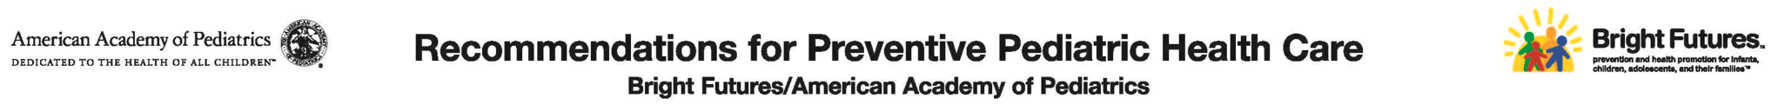
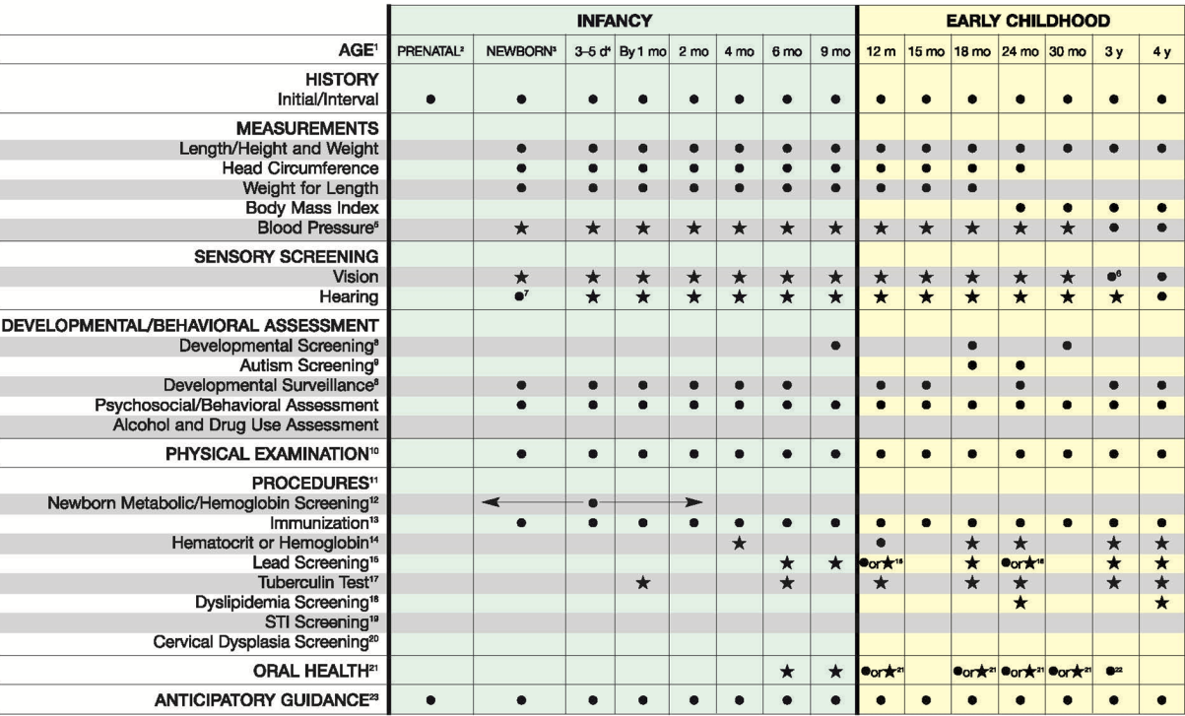
Notes:
The AAP’s periodicity schedule for recommended preventive health care services provides several opportunities for primary care pediatricians to promote early brain development as well as assess for developmental, behavioral and social-emotional concerns.
This graphic from the American Academy of Pediatrics, Committee on Practice and Ambulatory Medicine and Bright Futures Steering Committee’s recommendations for preventive pediatric health care shows some of the EBCD related items that are already taking place such as lead screening psychosocial and behavioral assessments etc.
Source: American Academy of Pediatrics, Committee on Practice and Ambulatory Medicine and Bright Futures Steering Committee. Recommendations for preventive pediatric health care. Pediatrics. 2007;120(6):1376

Slide 19
Take Home Messages
First 1000 days are not so much about what to DO …
Not ordering a specific methylation test
Not giving a specific standardized screen
Not referring to a specific resource
(although all of these may be appropriate)
…More about what to SEE!
Notes:
First 1000 days are not so much about what to DO …
Not ordering a specific methylation test
Not giving a specific standardized screen
Not referring to a specific resource
(although all of these may be appropriate)
It’s really about skilled, intentional observation and information-gathering, first and foremost.

Slide 20
Developing a Shared “VISION”
Toxic Stress
It’s like a snake!
It’s like a straw fan!
It’s like a tree trunk!
Notes:
We have things upside down and our system needs to change
To try and change things, we need to develop a shared vision
Pediatricians can’t do it alone – we need to partner with early education and child care, health departments, child protective services and others
However, we need to play a role at each level
How do we bring people together? (explanation of elephant)
Proverb – 3 blind men that experience an elephant
The first man says “An elephant is like a straw fan (he experienced the tail)
The second man says “No, an elephant is like a tree trunk (he experienced the legs)
The third man says “No, an elephant is like a snake (he experienced the trunk)
Childhood adversity is like this in that it is interpreted differently

Slide 21
Take Home Messages
This is not to say that if bad things happen there are necessarily long term negatives.
Notes:
This is not to say that if bad things happen there are necessarily long term negatives.
Protective interventions such as
Consistent supportive relationships with caring adults,
Supportive environments, like high quality childcare and early intervention programs
Can serve as buffers and mitigate or lesson the effects of adverse childhood experiences

Slide 22
Take Home Messages
Change the LENS we use to PRIORITIZE how we use our limited time with families:
  Use an ecobiodevelopmental framework
  Understand life-course theory and developmental trajectories
  Know the biological threats to healthy life courses
  Identify/address environmental risks early
  Whenever possible, proactively build wellness
Notes:
We are not asking clinicians to do something dramatically different or extended with the limited time they have with families. Rather, we’re asking to change the “lens” to make the best use of that time to address priorities.

Slide 23
Promote the Five R’s of Early Childhood Education
Reading together as a daily family activity
Rhyming, playing, talking, singing and cuddling together often
Routines and regular times for meals, play and sleeping, which help children know what they can expect and what is expected of them
Rewards for everyday successes, realizing that praise from those closest to a child is a very potent reward
Relationships that are reciprocal, nurturing and enduring are the foundation of healthy child development
Notes:
What can you do? Help promote the Five R’s of early childhood. These may seem simple, but implementing these behaviours and approaches at home can have profound consequences for children’s lives. For example, daily reading together and regular bedtime were two practices found in the most “successful” families in one study. (Source (GIVE FULL CITE): The Millennium Cohort Study, 2010.)

Slide 24
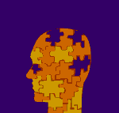
It is easier to build strong children than to repair broken men.
Frederick Douglass

